Slide 1

Teammate Compatibility: Improving Group Performance Amongst Employees
Kimberly Hall-Martin
Bellevue University
DSC 680
Notes:
Introductions

Slide 2
Introduction
ABC corporation is trying to improve team building and efficiency amongst employees working on projects together.
They believe that if employees with like personalities are paired together, they will have better computability and outcomes on the projects they are working on.
20,000 of their employees were given a personality test to complete.
Scale from 1 (low- this does not apply to them) to 10 (high-this does apply to them) of how they perceive themselves in different categories.
30 categories to rate themselves
Notes:
ABC corporation is trying to improve team building and efficiency amongst employees working on projects together.
They believe that if employees with like personalities are paired together, they will have better computability and outcomes on the projects they are working on.
20,000 of their employees a personality test where they rate themselves on a scale from 1 (low- this does not apply to them) to 10 (high-this does apply to them) of how they perceive themselves in different categories.
There were over 30 categories to rate themselves in some of which include creativity, organization, and leadership.

Slide 3
Goals
Create a model that can use employee personality results to predict what type of personality category (introvert, extrovert, ambivert) the employee will fall into, so they can create teams accordingly.
Have better team compatibility amongst small groups
Increased communication amongst team members
Better results on projects and completing them more efficiently

Slide 4
Targeted Audience
Company stakeholders
Managers
Leaders within the company

Slide 5
Data Preparation
Started with relatively clean data
Change personality_type column to numeric
Used label encoder
Split into training and test set for models
Apply standard scaler
Notes:
This data was fairly clean and required limited data preparation. Personality_type was the only column that was not numeric, so a label encoder was used to change that. The data was split into training and tests sets, and a standard scaler was applied so the logistic, k nearest neighbors and random forest models could be fitted.

Slide 6
Tools Used
Exploratory Data Analysis
Correlation Heat Map
Box plot
Logistic regression
K nearest neighbors (KNN)
Random forest regression
Features Importance

Slide 7
Evaluation Methods
F1 score
Accuracy
Notes:
To measure how well each model fit accuracy and F1 scores were used to evaluate performance which are common methods of evaluation for the models chosen.

Slide 8
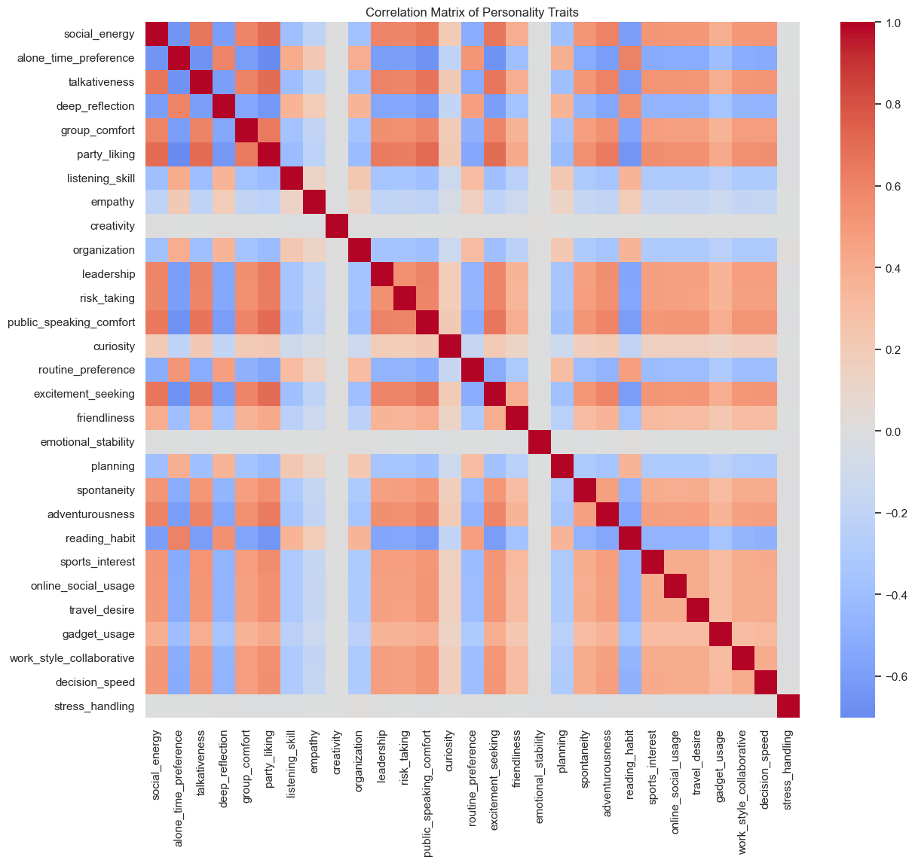
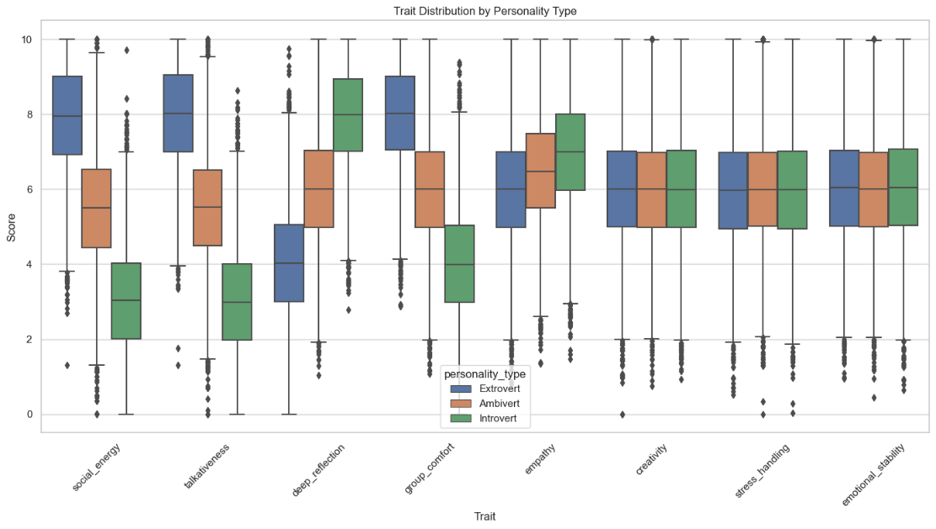
Results from Correlation Heat Map and Box Plot
Creativity, stress handling and emotional stability are not strongly correlated with one particular personality type
Notes:
The correlation heat map and boxplot visuals (Image 1 and 2) highlighted which traits were most often associated with each personality type. These images bring to attention that creativity, stress handling and emotional stability are not strongly correlated with one particular personality type.

Slide 9
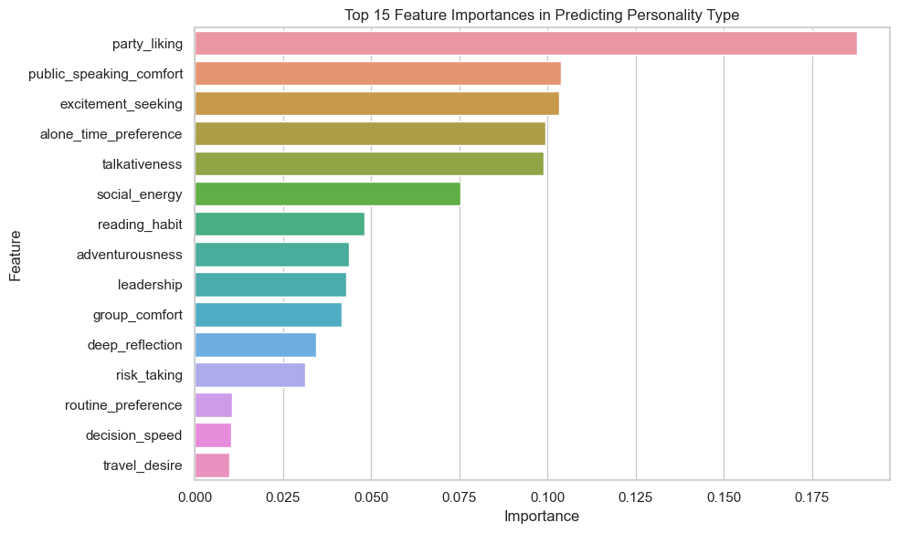
Features Importance
Party liking
Public speaking comfort
Excitement seeking
Notes:
The top features in predicting personality type were party liking, public speaking comfort and excitement seeking

Slide 10
Conclusions
Social interests and factors most affect a personality type.
Those who have high rating for social features, tend to be more extroverted.
Those who scored low for social features, tend to be more introverted.
Factors regarding a person’s character (empathy, stress handling, emotional stability, and creativity) least affect personality type.
Notes:
After analyzing this data, it was discovered that social interests and factors are what most affect a person’s personality type. Factors regarding a person’s character (empathy, stress handling, emotional stability, and creativity) had little impact on their personality type. All the characteristics that would theoretically make a good employee, do not impact personality type. Social traits, which assumedly have less impact on work ethic, are what decide personality type the most.

Slide 11
Recommendations
Create teams based on personality type results.
Do not share specific data with employees, label groups as A, B, and C
Create groups using current employees
Have new employees take personality test and then sort into teams
Do NOT use during the hiring process, only after an employee has been hired
Analyze performance after one year
Increase in communication and teamwork?
Employees retake personality test each year
Change groups if necessary
Notes:
Recommendations would be to take this information and create your teams based on the personality result types. It is recommended that this data not be shared with employees, simply label groups as something inconspicuous such as group A, group B and group C.
To implement this plan, it is recommended to start with the employees you already have and categorize them into new teams. As you hire new employees, during the on boarding process have them take the personality test so they can be sorted into their teams at the very beginning.
It is recommended to analyze performance after one year to see if sorting teams by personality type is successful in increasing communication and teamwork. It is also suggested to have employees retake their personality test every year. Many factors can affect human mood and behavior and retesting yearly can keep up with those changes.

Slide 12
Q&A

Slide 13
References
GeeksforGeeks. (2025, January 20). Getting started with Classification. https://www.geeksforgeeks.org/machine-learning/getting-started-with-classification/
The personality data set was obtained from Kaggle
https://www.kaggle.com/datasets/miadul/introvert-extrovert-and-ambivert-classification/data
GitHub Link for Code
https://github.com/kimhall1/Personality-Type-Prediction-Project-2.git

